Slide 1
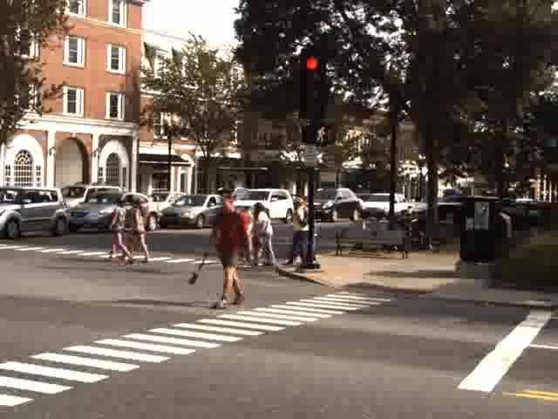
Notes:
Unedited image

Slide 2
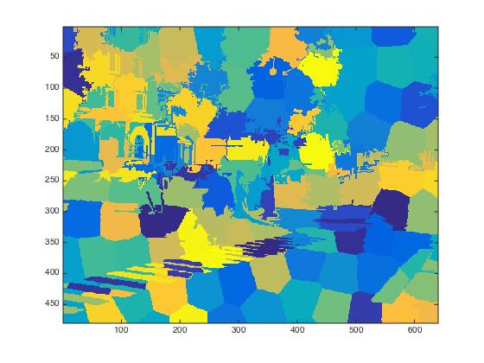
Notes:
Original code

Slide 3
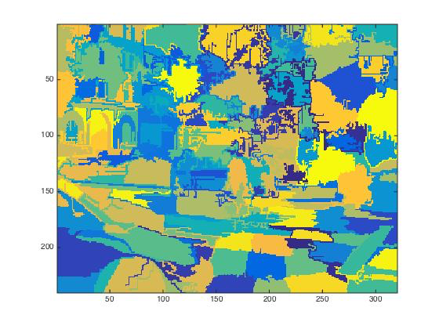
Notes:
My liney code

Slide 4
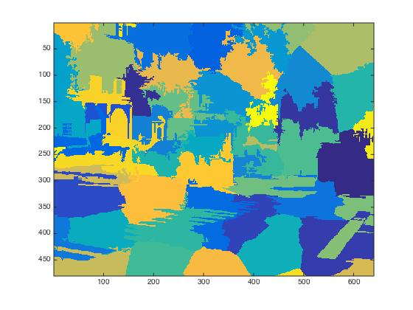
Notes:
My liney code, fixed

Slide 5
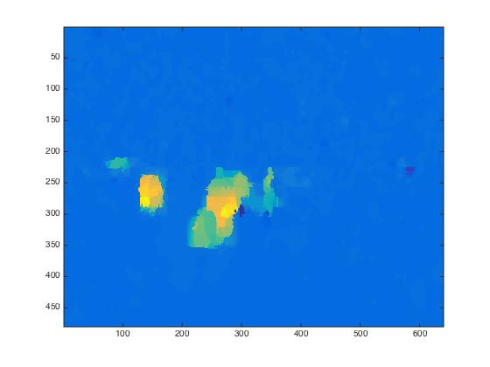
Notes:
Optical flow

Slide 6
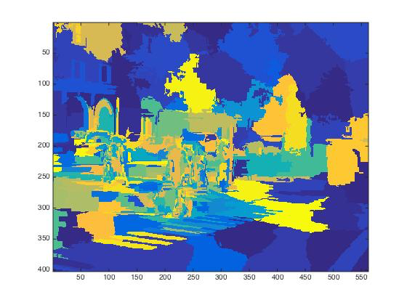
Notes:
Brute force split

Slide 7
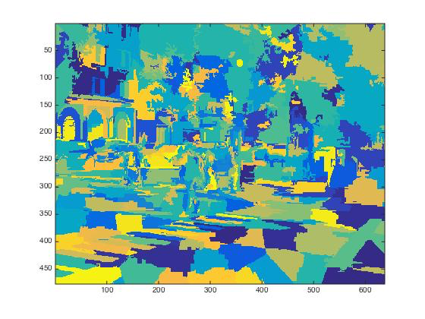
Notes:
Gravity-based split

